Slide 1
Module 2 The Relational Data Model Chapter 1
Update Operation

Slide 2
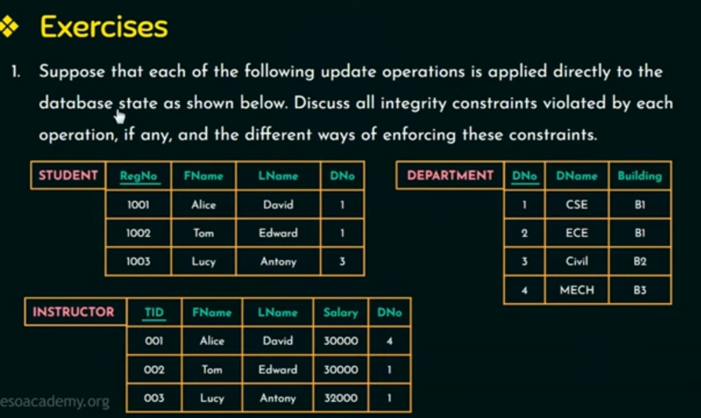

Slide 3
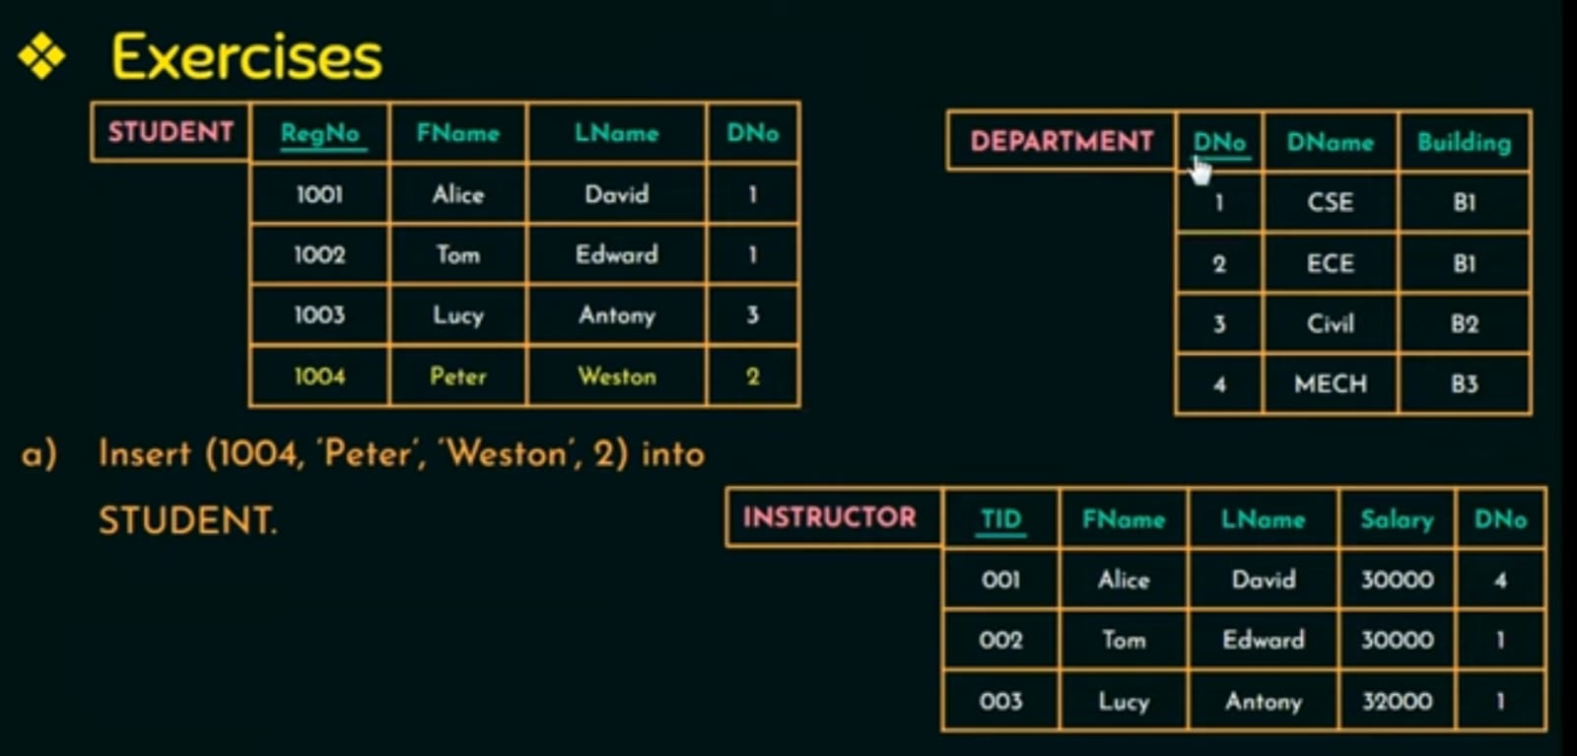

Slide 4
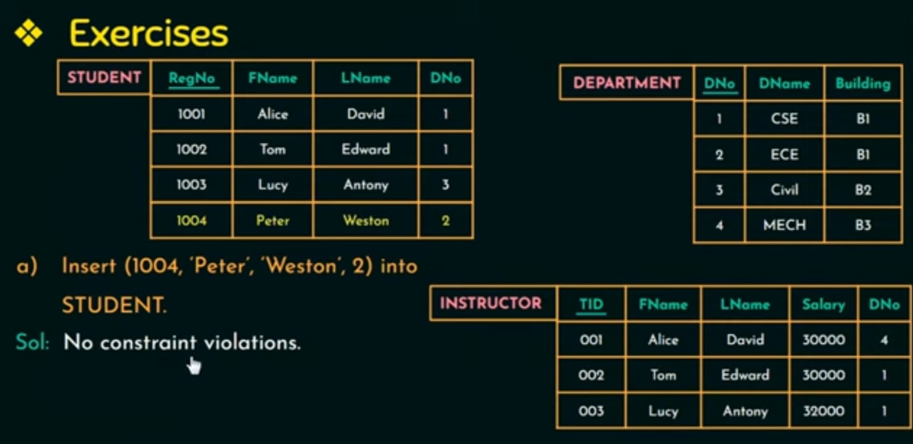

Slide 5
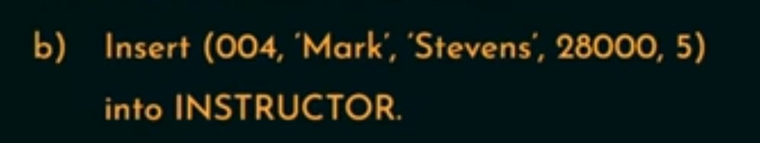
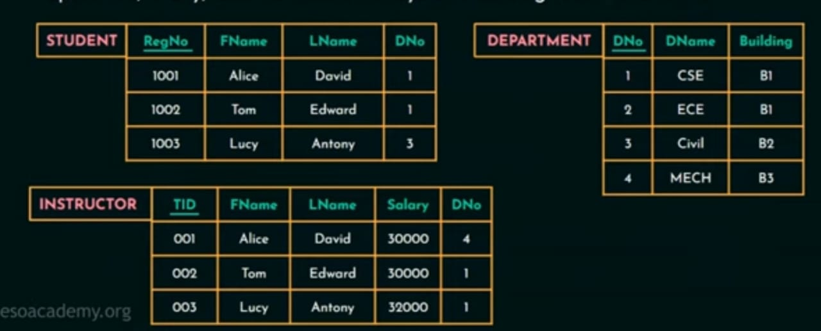

Slide 6
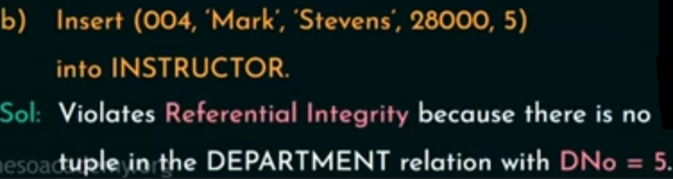
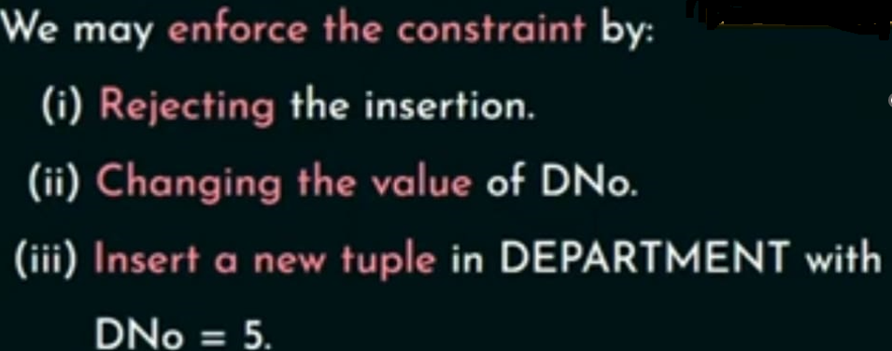

Slide 7


Slide 8
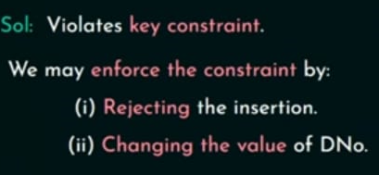

Slide 9


Slide 10
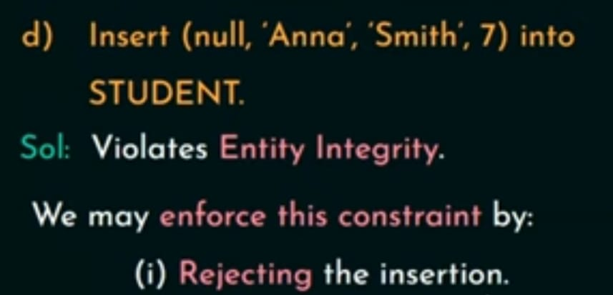

Slide 11
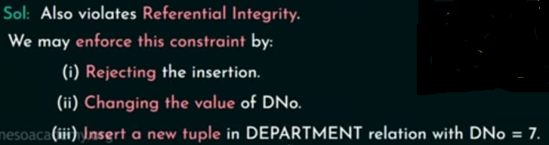

Slide 12


Slide 13
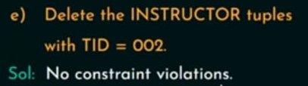


Slide 14

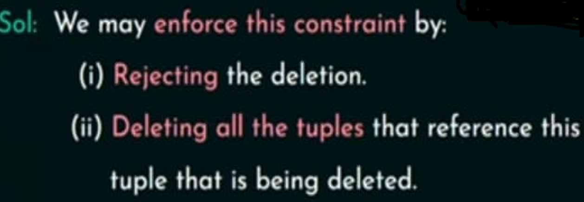

Slide 15


Slide 16
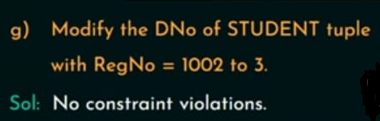
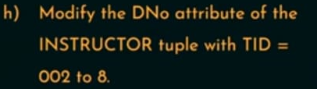

Slide 17
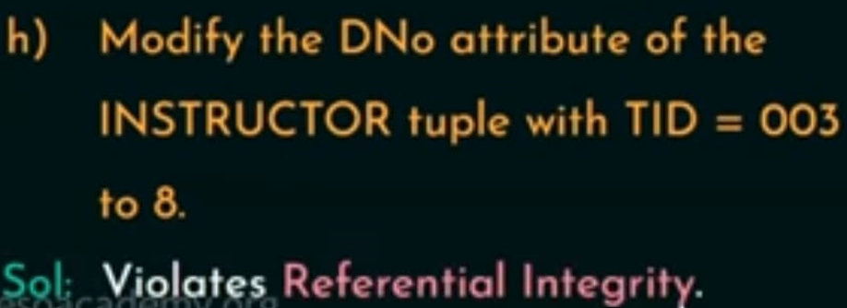
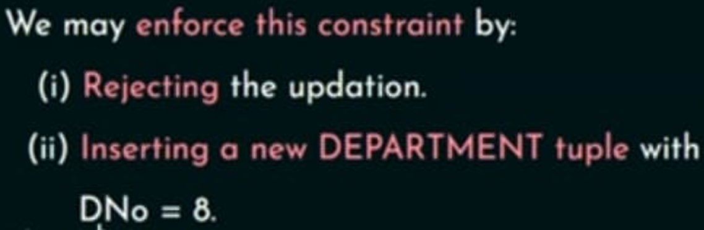

Slide 18
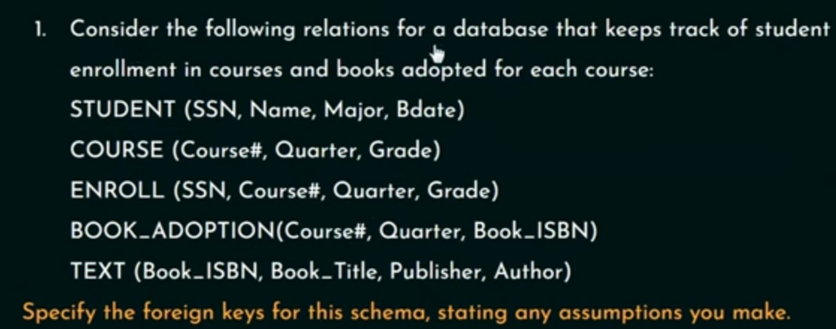
In relation STUDENT attribute SSN(student security number) is a primary key.
In relation COURSE attribute Course# is a primary key.
In relation ENROLL SSN and Course# together are primary key.
In relation TEXT Book _ISBN is a primary key.

Slide 19
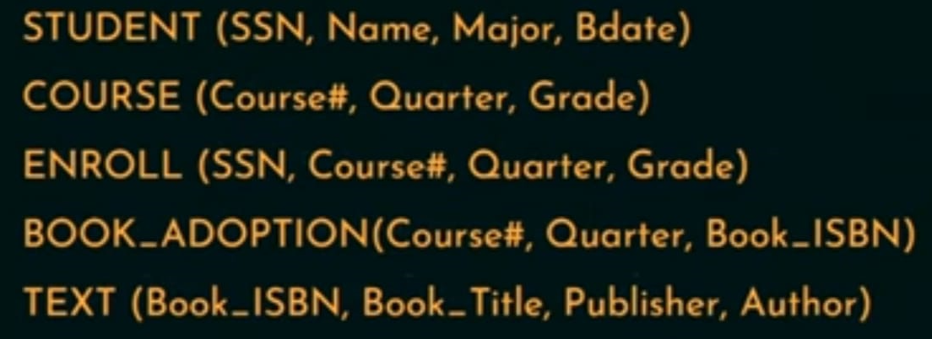
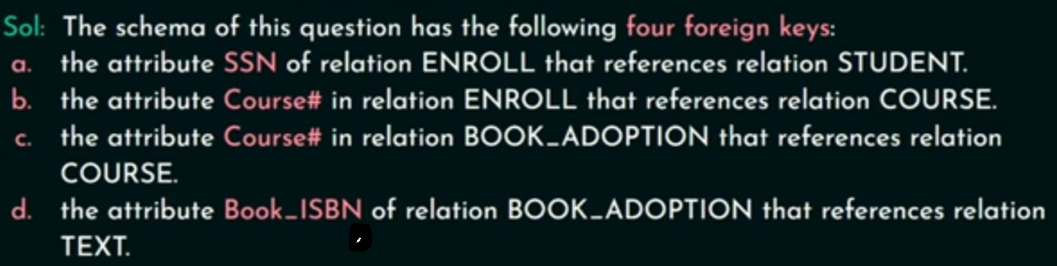

Slide 20
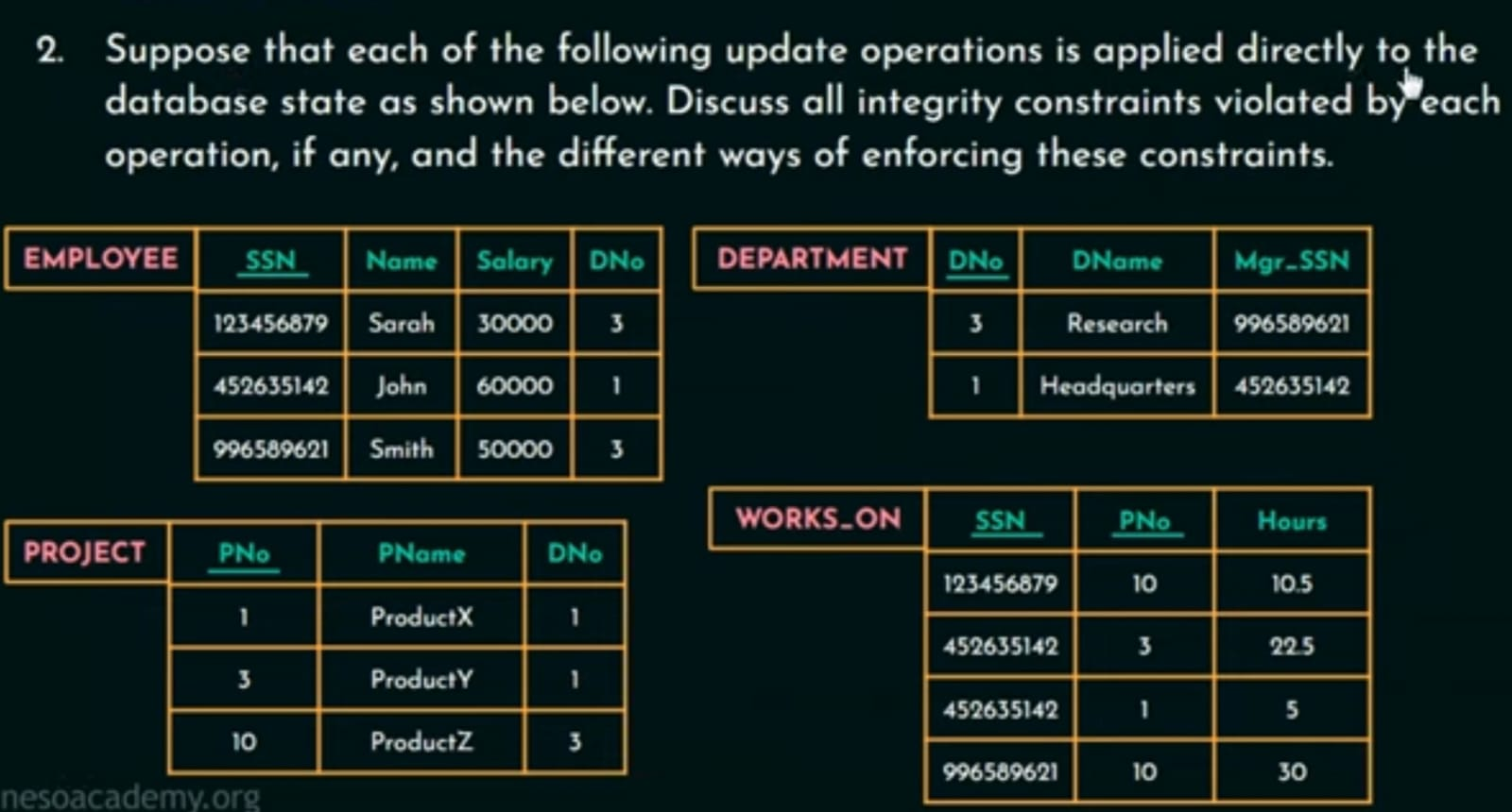
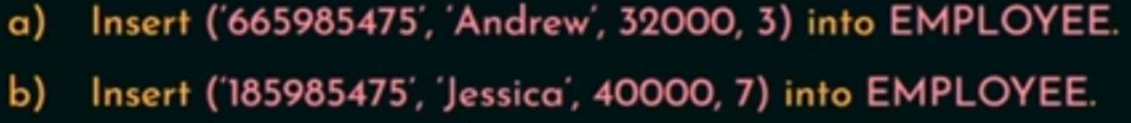

Slide 21
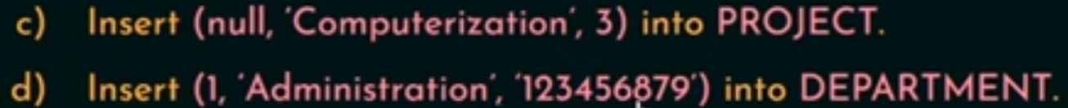

Slide 22
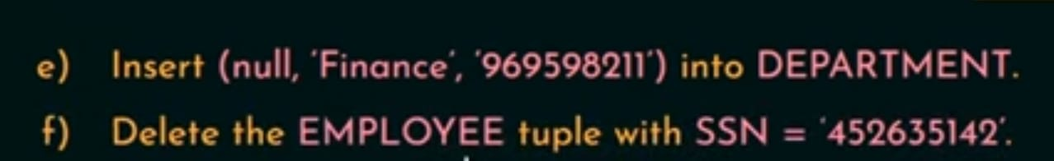

Slide 24
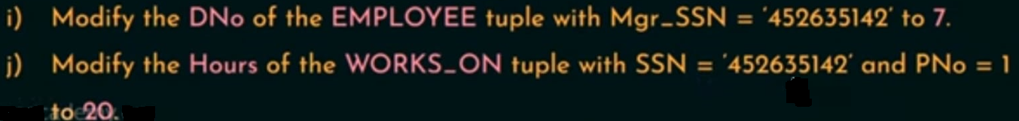

Slide 25
Chapter 2
Relational Algebra

Slide 26
Relational Algebra
It is basically procedural query language.
It means we need to instruct what to do how to do. Expecting the result from the database and the result is going to be a table or a relation and in order to get that result the table or the relation we need to instruct what is required and how to retrieve that data or how to retrieve the result that is why relational algebra is refer as a procedural query language.
Relational Algebra is a set of operations on relations.
It is a set of algebraic operations.
It takes one or more relation as input and produces a relation as an output

Slide 27
Input: One or more relation.
If input is one it comes under unary operator if input is two it comes under Binary operator if input is three it comes under ternary Operator.
Output: A relation.
Why we need to study relational algebra?
It provides a theoretical foundation for relational databases.
It allows us to understand database operations in more details and motivate us to write optimized queries.

Slide 28
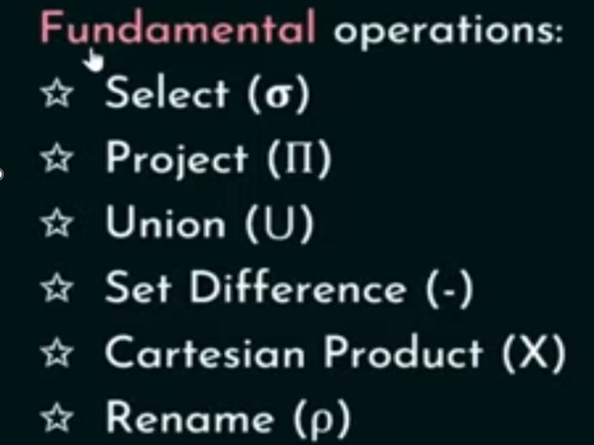
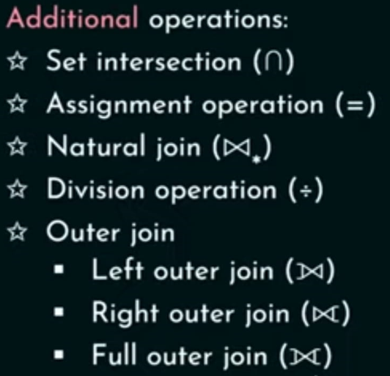
Relational Algebra Operation
Relational Algebraic Operations are classified into fundamental operations and Additional Operations.

Slide 29
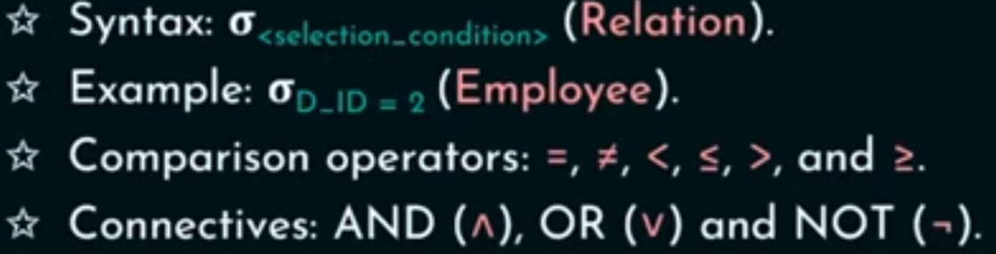

Select Operation
Select operation Select tuples that satisfy a given predicate or condition.
It is denoted by sigma ($σ).$

Slide 30
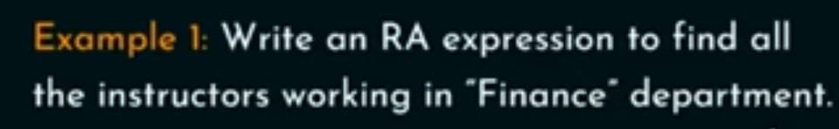
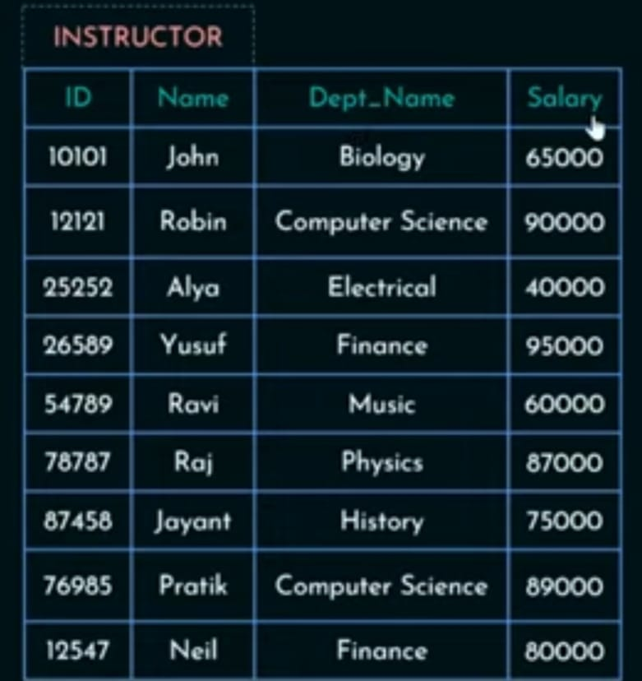

Slide 31
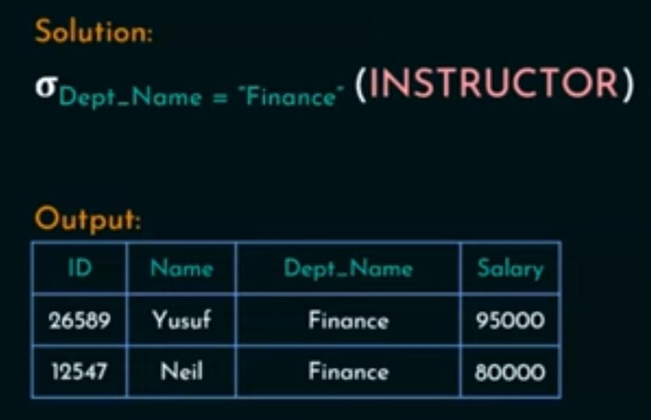

Slide 32
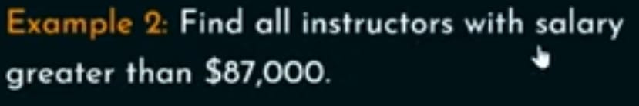

Slide 33
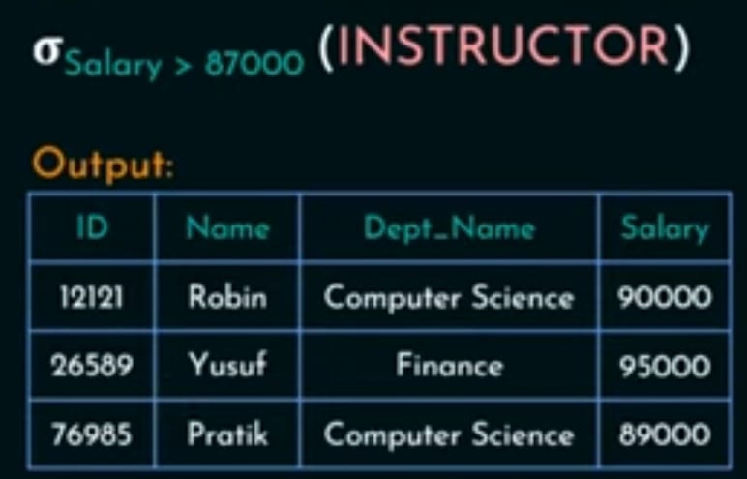

Slide 34
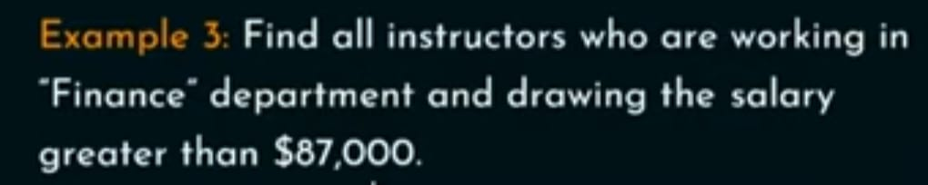

Slide 35
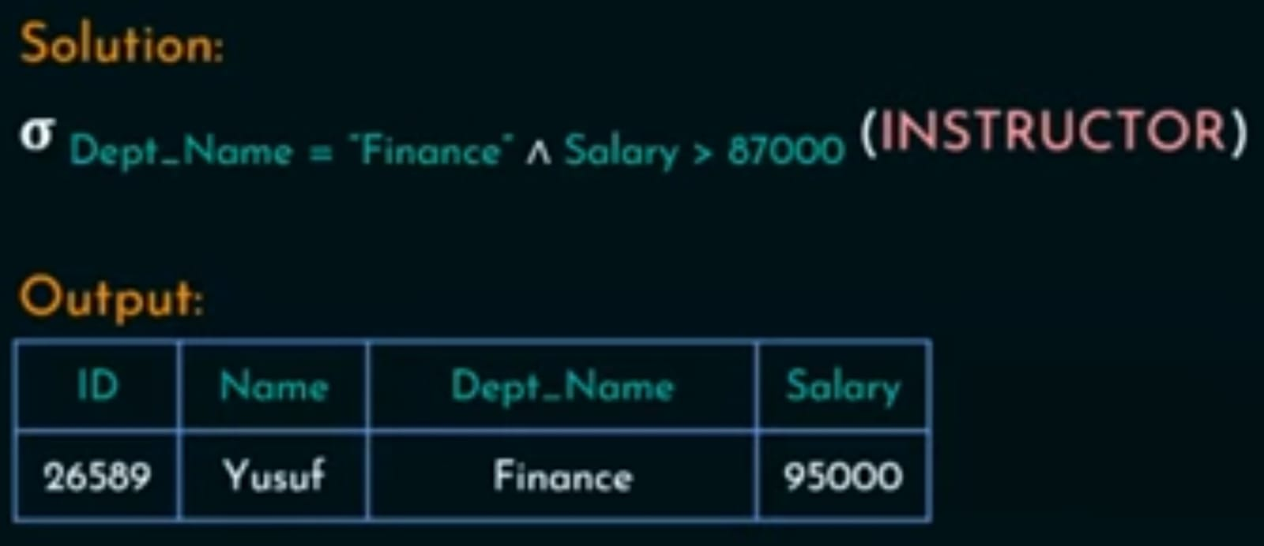

Slide 36
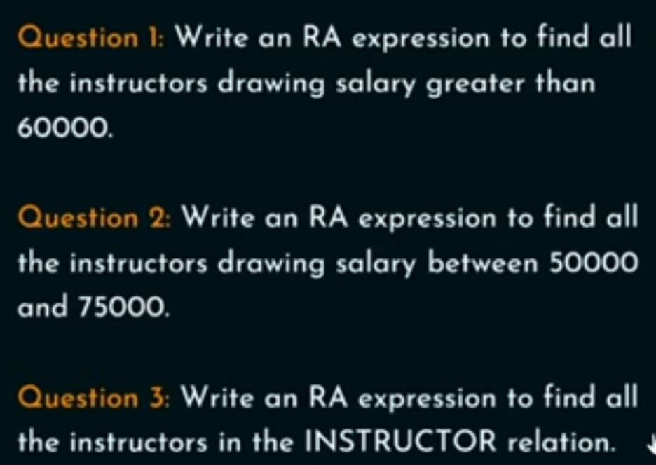

Slide 37
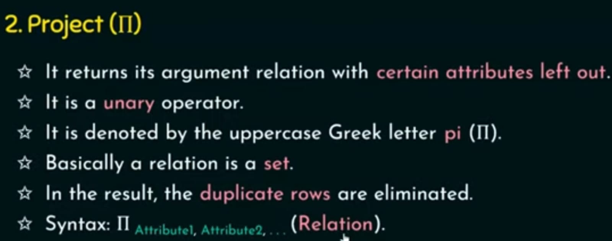

Slide 38
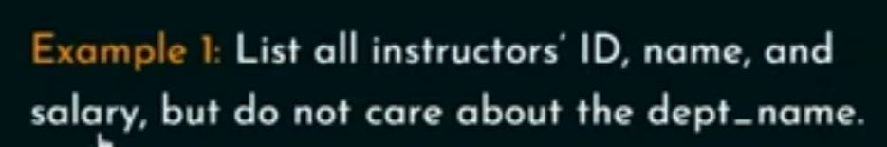

Slide 39
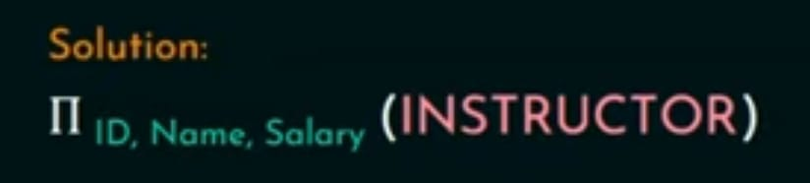
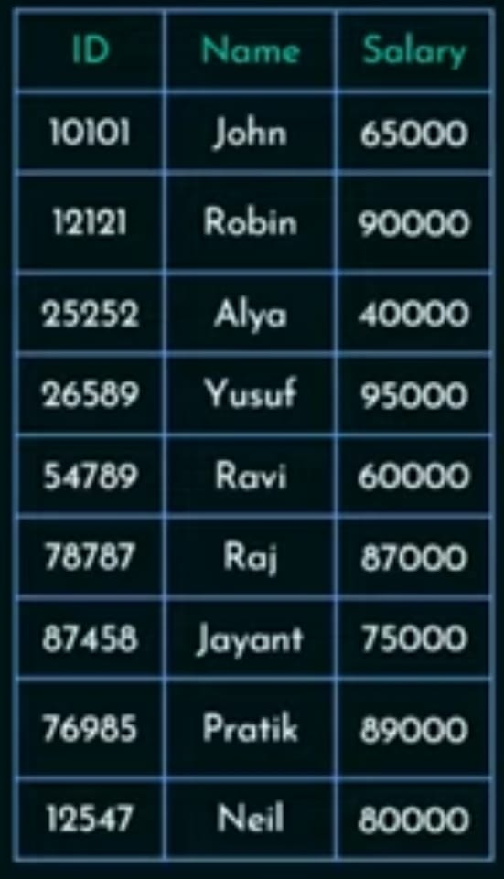

Slide 40
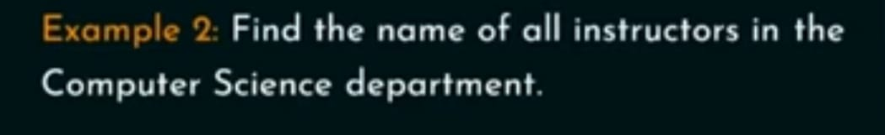

Slide 41
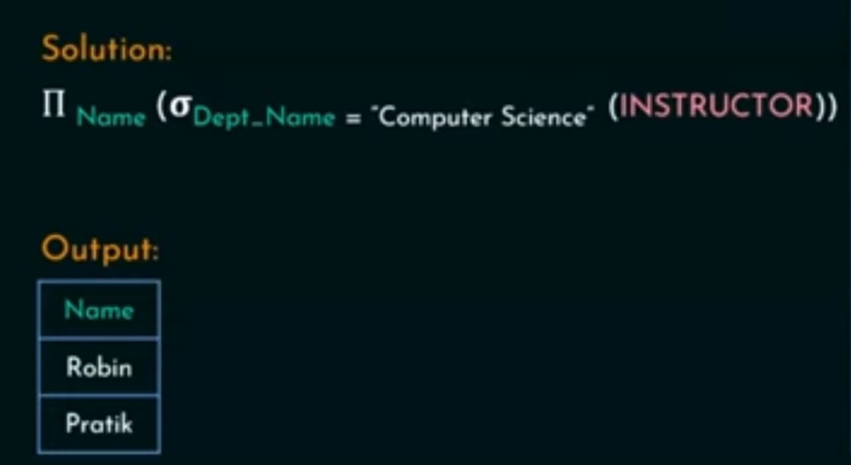

Slide 42
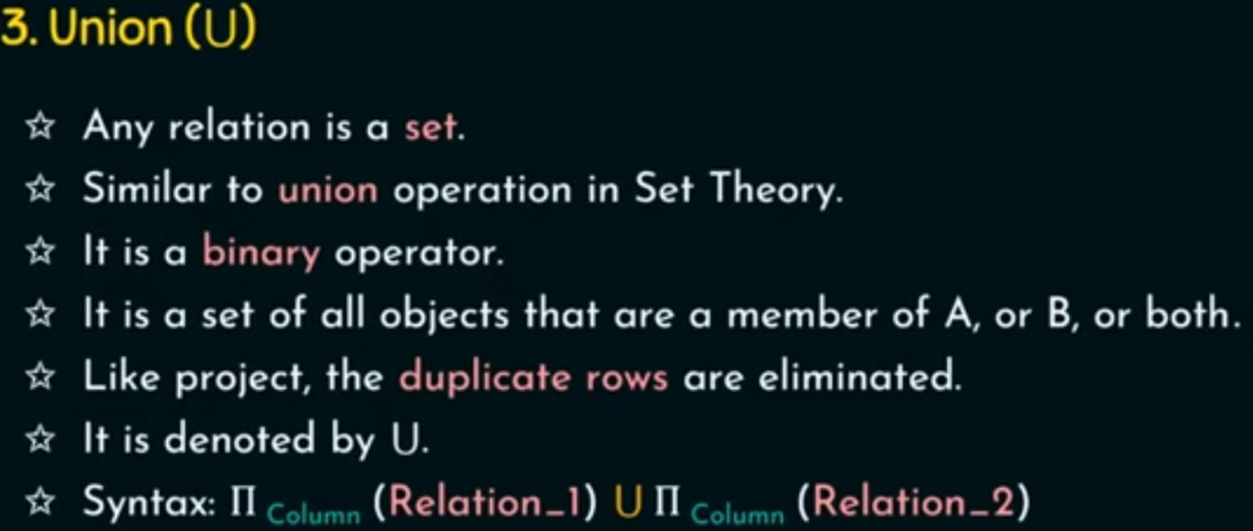
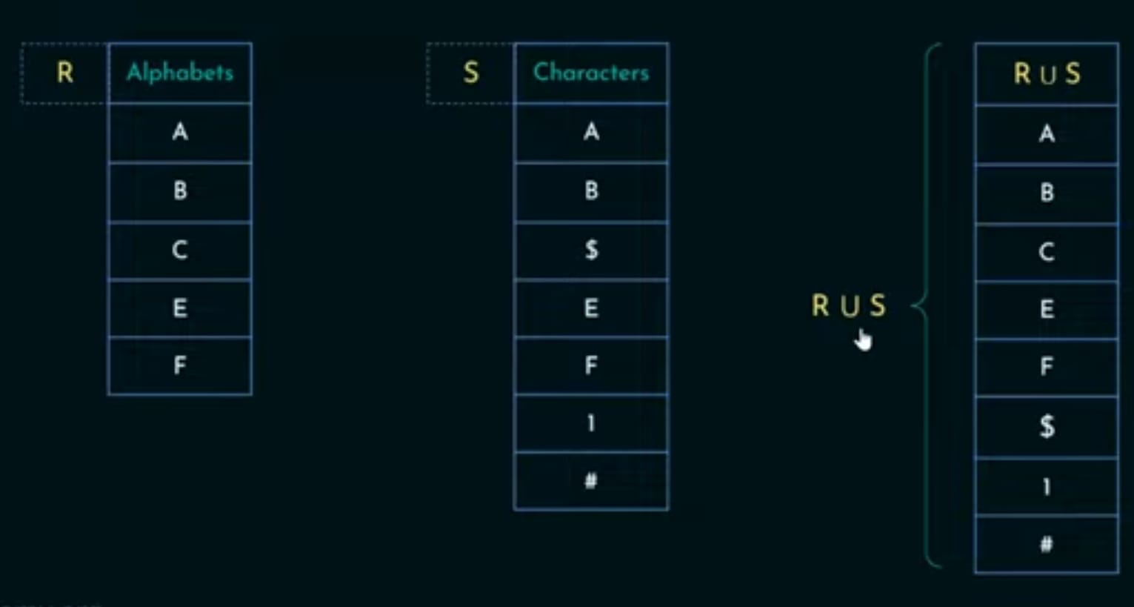

Slide 43
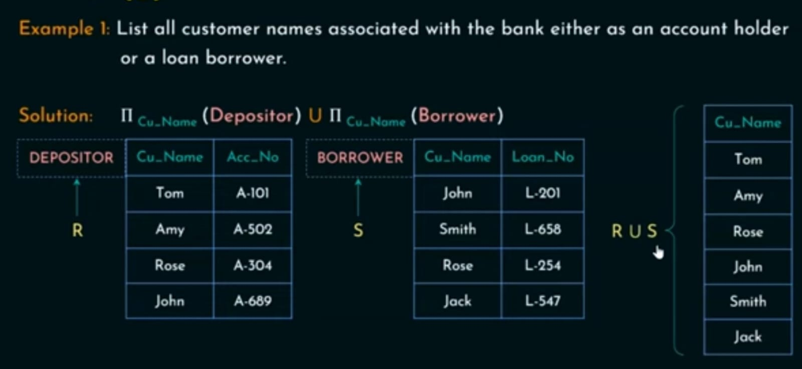

Slide 44
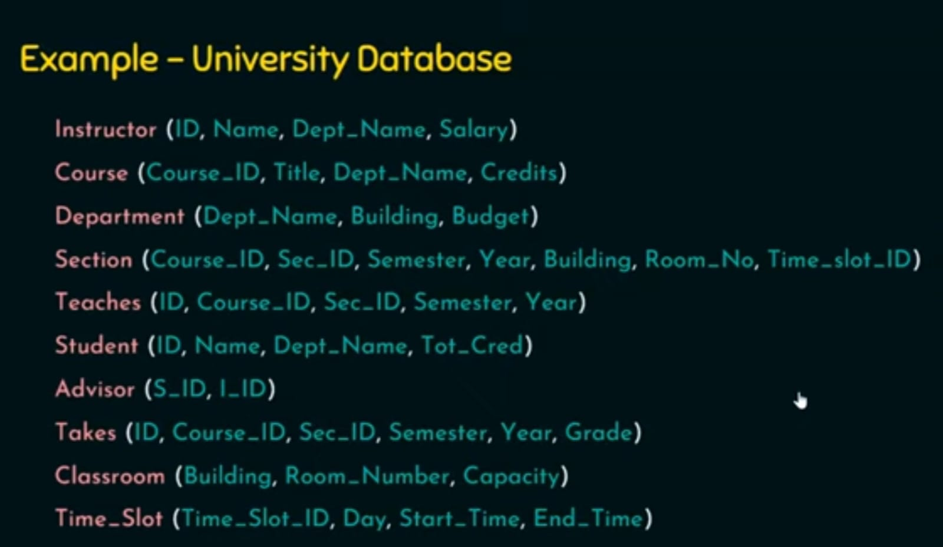

Slide 45
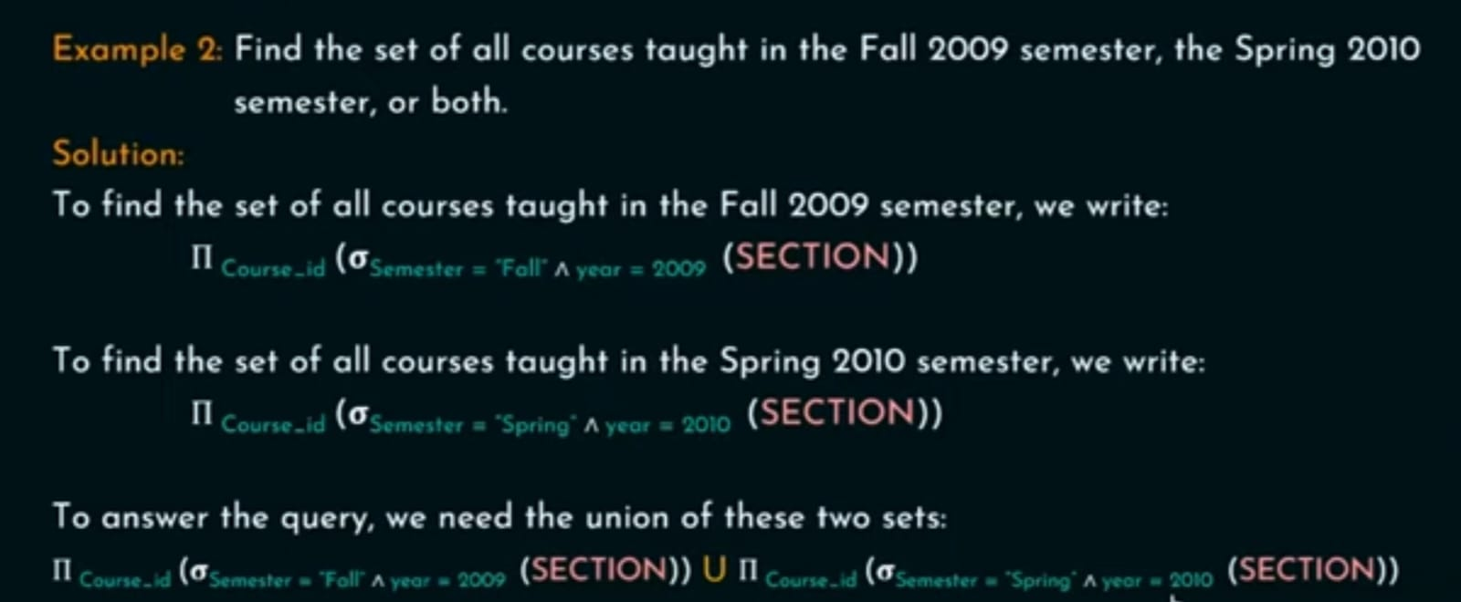

Slide 46
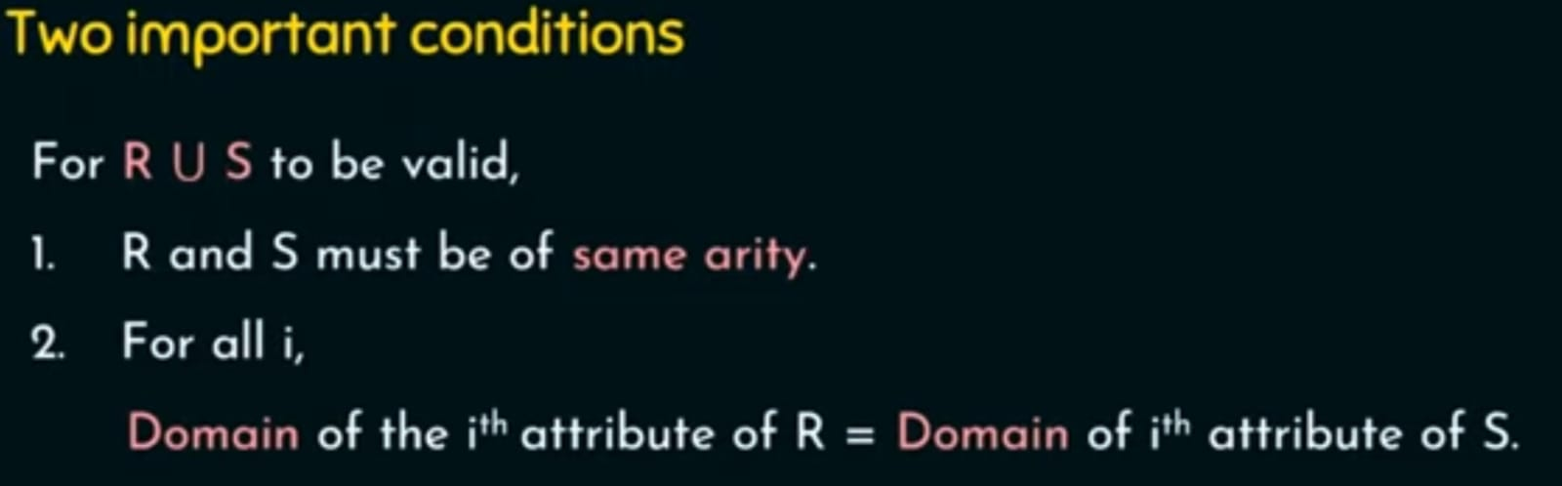

Slide 47
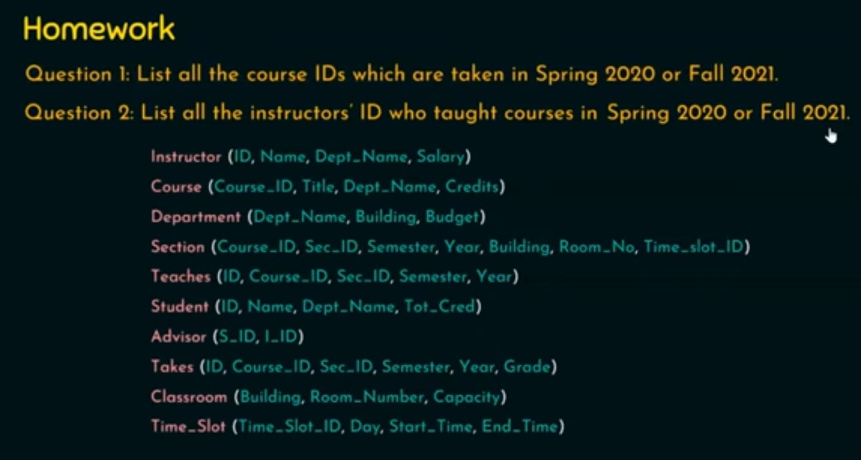

Slide 48
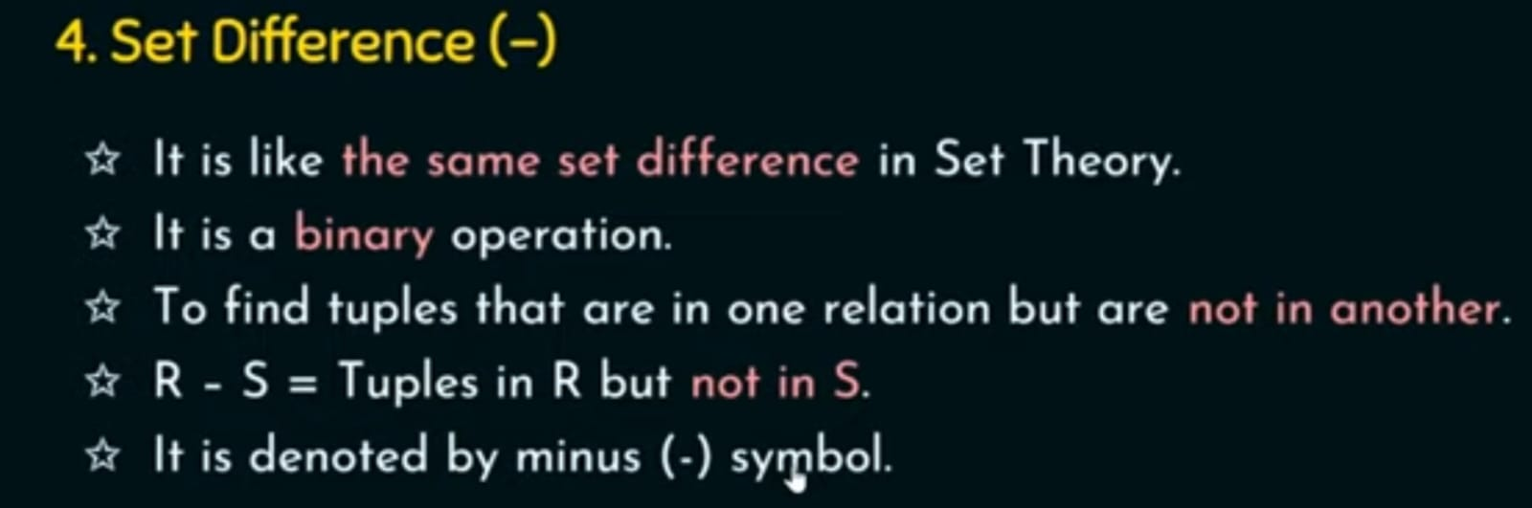


Slide 49


Slide 50


Slide 51


Slide 52


Slide 53



Slide 54


Slide 55


Slide 56


Slide 57


Slide 58


Slide 59


Slide 60


Slide 61



Slide 62


Slide 63


Slide 64


Slide 65


After Rename the Attribute_list (name, course_id) to Ins_Phy

Slide 66


Slide 67


Slide 69


Slide 70


